Slide 1

Notes:
JER

Slide 2

Containers for the modern IT Pro
Jan Egil Ring | Microsoft MVP
@JanEgilRing
Øyvind Kallstad| Microsoft MVP
@okallstad
Notes:
JER

Slide 3

Agenda
Containers - what it is and what it's not
Docker
Demos
Orchestration
Notes:
JER

Slide 4

Where do developers spend time…
Debugging existing applications
“Fixing” existing applications
Adding “features” to existing applications
Fixing the feature someone else added
Building a new application (maybe… if there’s time)
Notes:
JER

Slide 5

Where do application admin’s spend time…
Maintaining existing applications
Re-deploying existing applications
Diagnosing issues with existing applications
Troubleshooting issues from feature additions
Deploying a new application (maybe… if there’s time)
Notes:
JER

Slide 6
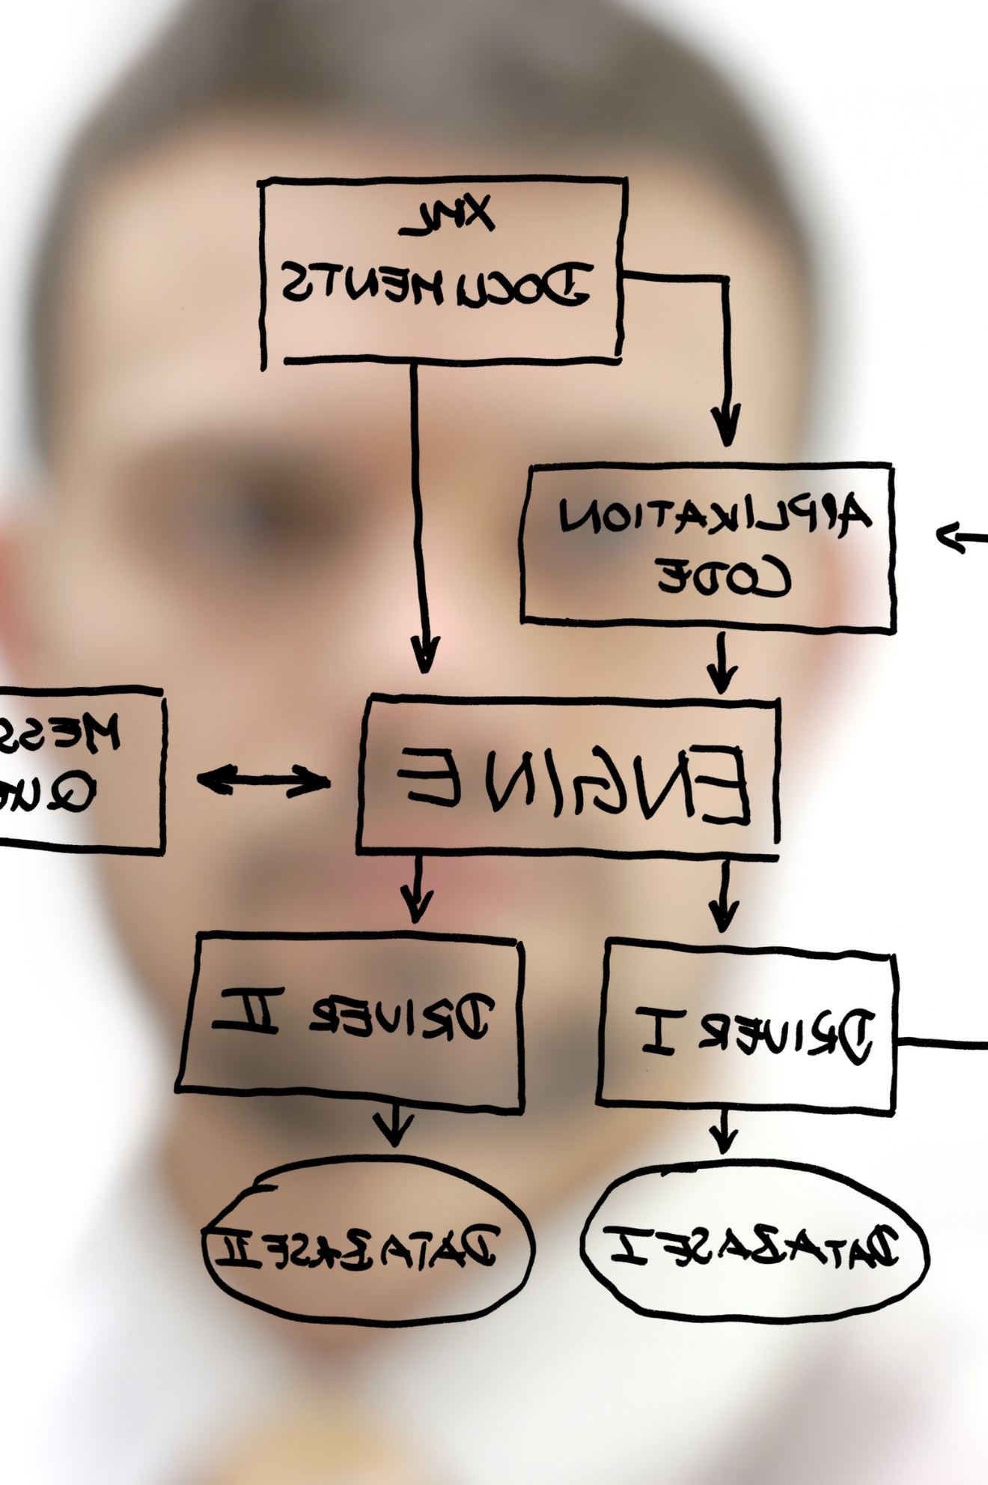
Making old new…
We can’t stop adding features.
We can’t throw out every old app.
We can’t stop maintaining old apps.
We can make it easier…
We can use new tools/code with existing apps…
Notes:
JER

Slide 7

Where to start?
CONTAINERIZE EXISTING APPLICATIONS
Containerize for portability, efficiency and reliability
TRANSFORM MONOLITHS TO MICROSERVICES
New code and transforming existing code
ACCELERATE NEW APPLICATIONS
Agile cloud native app development
Notes:
JER

Slide 8

Why containers?
Transforming Existing Applications into Cloud Applications
Is Hard!
Building Hybrid Cloud
Applications
Is Hard!
http://www.gettyimages.com/license/649171837
Notes:
JER

Slide 9

Why containers?
Containers Make It Much Easier…
http://www.gettyimages.com/license/606349595
Notes:
JER

Slide 10
How do containers make it easier?
Consistency
Efficiency
Rapid
Deployment
Fast Iterations
Service Separation
High Availability
Reproducibility
On Any Cloud
Scalability
Test at Scale
Immutability
Reduced Costs
Notes:
JER
Consistency example: Not like for example Hyper-V and VMware which both have different file types and makes it difficult to migrate between clouds without a conversion process.

Slide 11
Startup Performance
NodeJS with Nano Server
Windows Server Container
Under 600 Milliseconds!
Hyper-V Container
~1.75 seconds
A virtual machine takes ~3 seconds
NodeJS with Windows Server Core
Windows Server Container
~1 second
Hyper-V Container
~3.3 seconds
A virtual machine takes ~5 seconds to over a min
Notes:
JER

Slide 12
Density
NodeJS with Nano Server
Windows Server Container
First Container ~120MB
Additional Containers ~75MB
Hyper-V Container
First Container ~340MB
Additional Containers ~150MB
NodeJS with Windows Server Core
Windows Server Container
First Container ~150MB
Additional Containers ~75MB
Hyper-V Container
First Container ~555MB
Additional Containers ~280MB
Notes:
JER

Slide 13
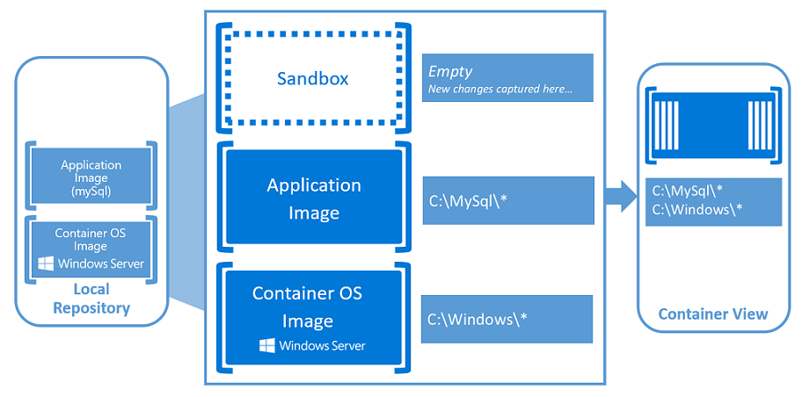
Architecture
Notes:
OK
Layering

Slide 14
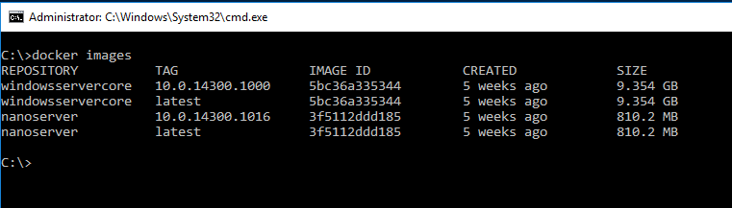
Base images
Example base images
windowsservercore: large , highly compatible
nanoserver: small, fast, smaller API surface
alpine: small, fast, docker optimized Linux distro
docker pull
microsoft/windowsservercore
microsoft/nanoserver
alpine
Notes:
OK

Slide 15
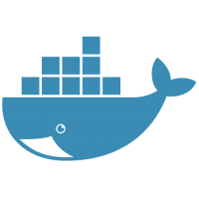


Docker
Docker improves the deployment of applications with portable, self-sufficient containers, Linux or Windows, that can run on any cloud or on-premises.
No more:
“It works in my dev machine!...
Why not in production?”
Now it is:
“If it works in Docker, it works in production”
Keywords about WHY Docker?
Dependencies (self-sufficient)
Deployment
Notes:
OK
Slide from Ignite BRK3317

Slide 16
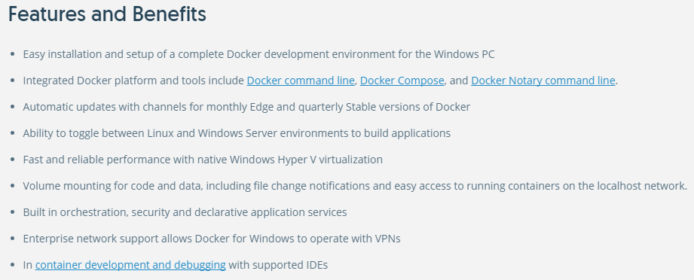
Docker for Windows
Notes:
OK
An integrated, easy-to-deploy development environment for building, debugging and testing Docker apps on a Windows PC. Docker for Windows is a native Windows app deeply integrated with Hyper-V virtualization, networking and file system, making it the fastest and most reliable Docker environment for Windows.
https://www.docker.com/docker-windows

Slide 17
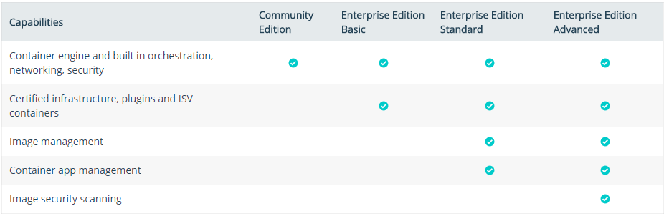
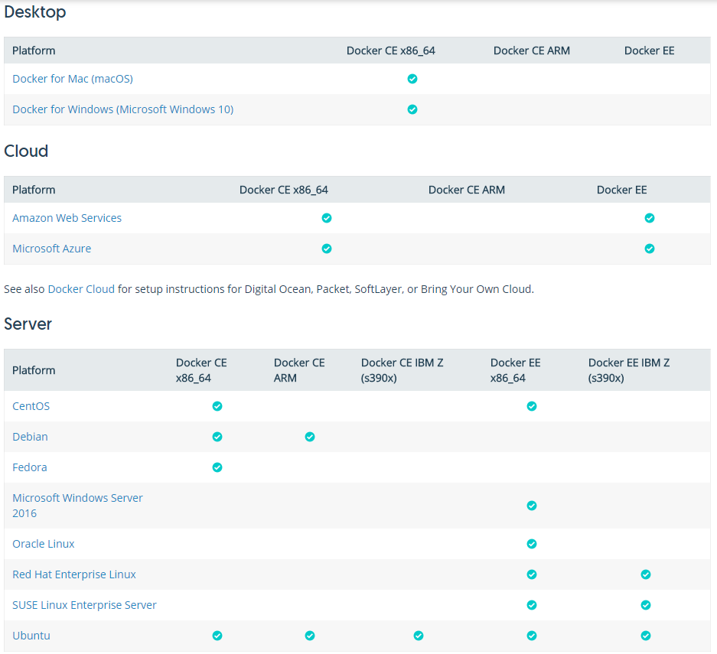
Editions
Notes:
OK
Docker is available in two editions: Community Edition (CE) and Enterprise Edition (EE).
Docker Community Edition (CE) is ideal for developers and small teams looking to get started with Docker and experimenting with container-based apps. Docker CE has two update channels, stable and edge:
Stable gives you reliable updates every quarter
Edge gives you new features every month
https://docs.docker.com/engine/installation/#desktop

Slide 18
Installation
The current version of Docker for Windows runs on 64bit Windows 10 Pro, Enterprise and Education (1607 Anniversary Update, Build 14393 or later).
Virtualization must be enabled.
Download from https://store.docker.com/editions/community/docker-ce-desktop-windows
Notes:
JER
If your system does not meet the requirements to run Docker for Windows, you can install Docker Toolbox, which uses Oracle Virtual Box instead of Hyper-V.

Slide 19
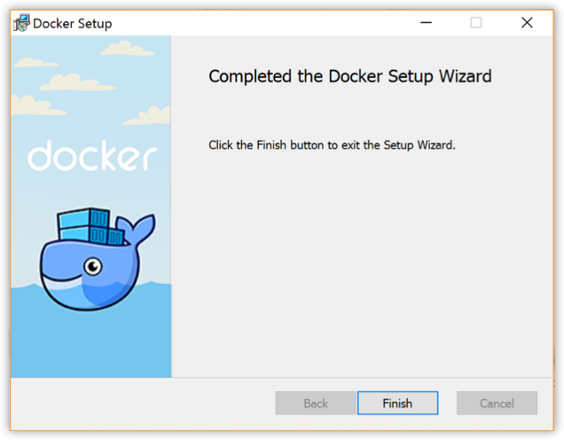
Demo
Exploring and configuring Docker for Windows
Set up tab completion in PowerShell
Switch between Windows and Linux containers
Notes:
JER
https://docs.docker.com/docker-for-windows/install/#start-docker-for-windows
https://docs.docker.com/docker-for-windows/
docker version
docker info
docker run hello-world
docker run -d -p 80:80 --name webserver nginx
Kitematic
Install-Module posh-docker

Slide 20
Demo
Basic operations in Docker
Notes:
OK

Slide 21
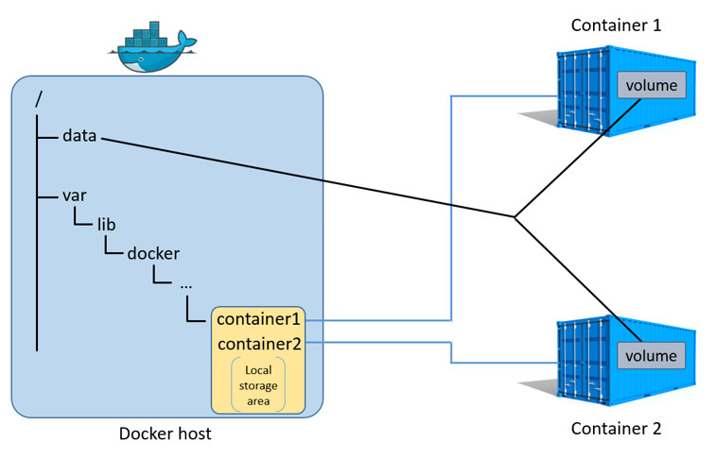
Container storage
Stateful vs Stateless
3 main scenarios
Data persistence when container is removed
Share data between container and host
Share data between containers
Other options
Network storage (plugins)
Gluster
iSCSI
Persistent data volumes on cluster shared volumes (Windows Server 2016)
SMB global mapping (Windows Server, version 1709)
Cloud Storage
Block storage: AWS EBS, Azure Blob Storage
Notes:
JER
Stateful:
-Secrets – keys, passwords
-Databases
-Log files
-Misc
Stateless
-No data stored on disk
-Web frontend
-Anything written to disk will be lost when the container is removed
“. In Windows Server, version 1709 as well as Windows Server 2016 with the latest updates, we’ve added support for containers to access persistent data volumes located on CSVs, including CSVs on Storage Spaces Direct. This gives the application container persistent access to the volume no matter which cluster node the container instance is running on.”
“In Windows Server, version 1709 we’ve added support for mapping an SMB file share to a drive letter inside a container – this is called SMB global mapping. This mapped drive is then accessible to all users on the local server so that container I/O on the data volume can go through the mounted drive to the underlying file share.”
More info:
https://docs.docker.com/engine/admin/volumes/volumes/
https://docs.docker.com/engine/admin/volumes/
https://www.gluster.org/
https://blogs.msdn.microsoft.com/clustering/2017/08/10/container-storage-support-with-cluster-shared-volumes-csv-storage-spaces-direct-s2d-smb-global-mapping/

Slide 22
Demo
Container storage
Notes:
JER
Map local folders (persistent data volumes)

Slide 23
Demo
Docker Hub
Notes:
OK

Slide 24
Where to start?
CONTAINERIZE EXISTING APPLICATIONS
Containerize for portability, efficiency and reliability
TRANSFORM MONOLITHS TO MICROSERVICES
New code and transforming existing code
ACCELERATE NEW APPLICATIONS
Agile cloud native app development
Notes:
JER

Slide 25
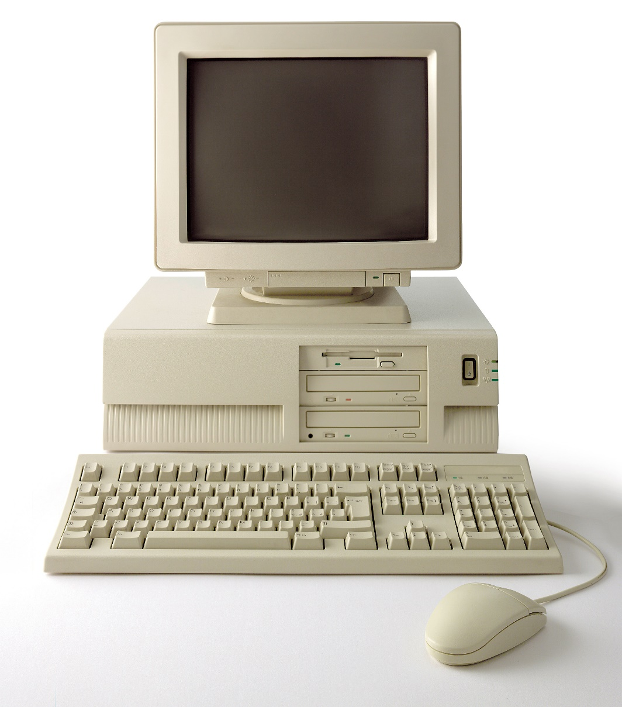
Image2Docker
Notes:
JER

Slide 26
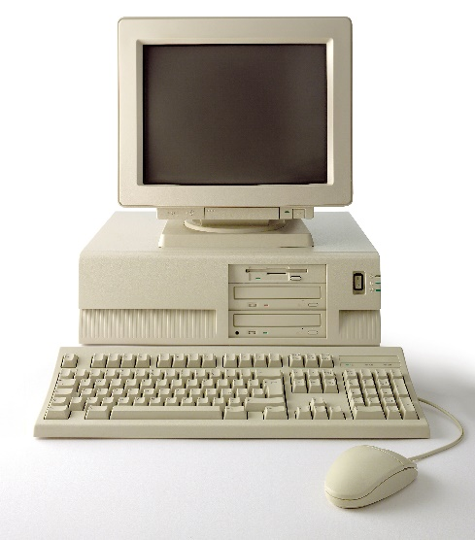
ConvertTo-Dockerfile `
-RemotePath \\192.168.1.5\c$ `
-OutputPath c:\newDockerFile `
-Artifact IIS
FROM microsoft/aspnet:windowsservercore-10.0.14393.693
SHELL ["powershell", "-Command", "$ErrorActionPreference = 'Stop'; $ProgressPreference = 'SilentlyContinue';"]
RUN Remove-Website 'Default Web Site';
# Set up website: iis-env
RUN New-Item -Path 'C:\iis\iis-env' -Type Directory -Force;
RUN New-Website -Name 'iis-env' -PhysicalPath 'C:\iis\iis-env' -Port 8090 -Force;
EXPOSE 8090
COPY ["iis-env", "/iis/iis-env"]
Notes:
JER

Slide 27

Image2Docker
Open source PowerShell module
WIM, VHD, VHDx or Live Servers
Roles and Features along with installed programs
Internet Information Services (IIS)
- HTTP Handlers in IIS configuration
- IIS Websites and filesystem paths
- ASP.NET web applications
Microsoft SQL Server Instances
Apache Web Server
https://www.powershellgallery.com/packages/Image2Docker/
https://github.com/docker/communitytools-image2docker-win
Get It
Notes:
JER

Slide 28
Demo
Image2Docker
Dockerfiles
Notes:
JER

Slide 29
Demo
Private docker repositories
Docker Registry
Notes:
OK

Slide 30
Demo
Operational tips & tricks
Docker logs (fetch the logs of a container)
Docker inspect (return low-level information on Docker objects)
Notes:
JER: logs/inspect

Slide 31
Where to start?
CONTAINERIZE EXISTING APPLICATIONS
Containerize for portability, efficiency and reliability
TRANSFORM MONOLITHS TO MICROSERVICES
New code and transforming existing code
ACCELERATE NEW APPLICATIONS
Agile cloud native app development

Slide 32
Hyper-V Containers
Some workloads need more isolation
Hostile multi-tenancy
Regulated workloads
Solution: transparently run each container in a VM!
(Mostly) invisible to both Docker and the user
docker run --isolation=hyperv
Hyper-V Containers are the default on Windows 10
Images are the same
Notes:
JE

Slide 33
Windows Server Containers
Host User Mode
System Processes
Session Manager
Container Management
Local Security Authority
Windows Server Container
Windows Server Container
Docker Engine
Event Manager…
System Processes
Application Processes
System Processes
Application Processes
Compute Services
Etc…
Job Object
Net Interface
Storage
Registry
Job Object
Net Interface
Storage
Registry
Windows Kernel
Notes:
JE

Slide 34
Hyper-V Containers
Host User Mode
Virtual Machine Specifically Optimized To Run a Container
System Processes
Session Manager
Hyper-V Container
Container Management
Local Security Authority
Windows Server Container
Guest Compute Service
Docker Engine
Event Manager…
System Processes
Application Processes
Compute Services
Basic System Processes
Etc…
Job Object
Net Interface
Storage
Registry
Windows Kernel
Windows Kernel
Hyper-V Hypervisor

Slide 35
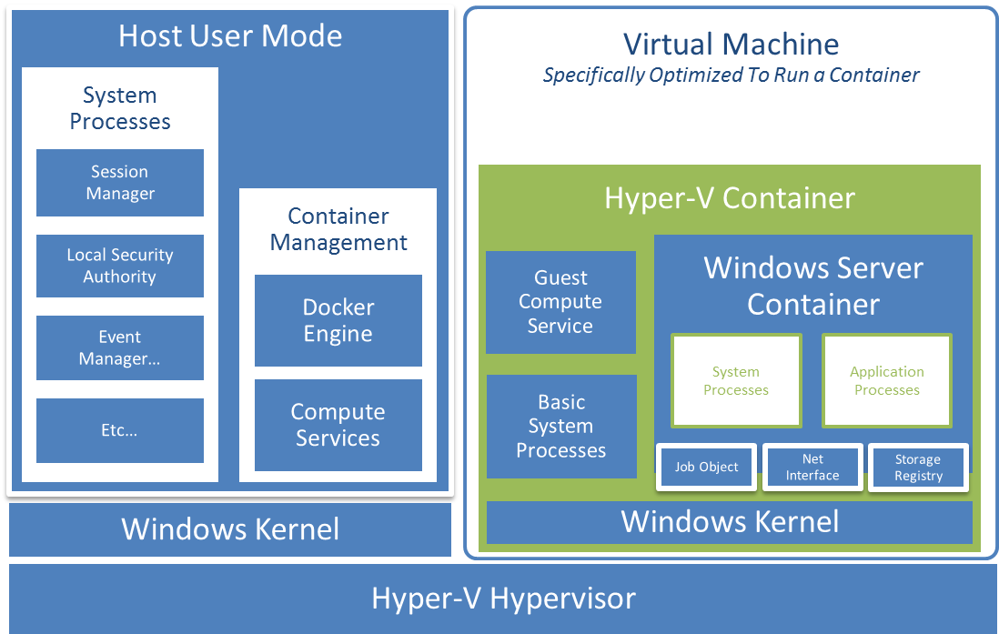
Making it work
Small, stateless “utility VM”
Smallest Windows yet?
Writes not persisted
Storage attached via SMB
VMBus transport
File cache sharing
Networking attached via virtual NIC

Slide 36
Linux containers with Hyper-V isolation
One Docker engine
Host User Mode
Hyper-V Isolation
Hyper-V Isolation
One container host
Container Runtime
Virtual Machine Specifically Optimized To Run a Container
Virtual Machine Specifically Optimized To Run a Container
Docker Engine
Windows Server
Container
Linux
Container
Any container,
regardless of OS
ContainerD
App
App
Choice of Linux kernels
Windows Kernel
Windows Kernel
Linux Kernel
Hyper-V Hypervisor
Available on Windows 10

Slide 37

Container Optimized Nano Server Image
Uncompressed container image 236 MB (WS 1709)
Removing components not relevant to
containers or modern development
Optional components are layers
Notes:
JE

Slide 38
Demo
Docker compose
Notes:
OK

Slide 39
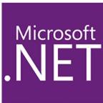
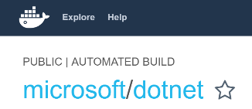
Docker and .NET
.NET Core Docker images
xPlat. (Linux & Windows Nano Server)
.NET Framework images
Windows Server Core
See at Docker Hub
Notes:
JER
Slide from Ignite BRK3317

Slide 40

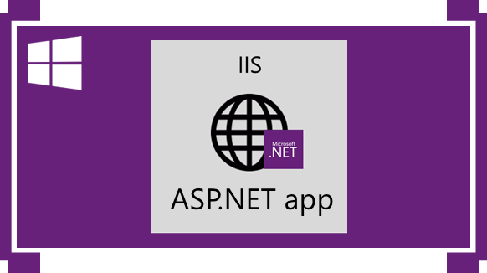
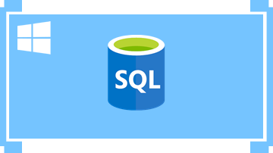

Why do you need orchestrators when moving to production?
How to scale-out application containers?
And with no IaaS/VM operations?
SQL Server on
Windows Server Core Container
Azure SQL Database
Or
Azure SQL Database Managed Instance
Or
SQL Server cluster on-premises
Orchestrators
High Availability
PaaS service
Notes:
JER

Slide 41





Getting started with Orchestrators
Azure Product
Orchestrator | Description | Good for | Common workloads
 | Azure Service Fabric is a distributed systems platform that makes it easy to package, deploy, and manage scalable and reliable microservices |  | Stateful svc & Actors Microservices based on plain processes Microservices based on containers
 | Docker Swarm is a clustering and scheduling tool for Docker containers. With Swarm, IT administrators and developers can establish and manage a cluster of Docker nodes as a single virtual system |  | Microservices based on containers
 | Kubernetes is an open-source platform for automating deployment, scaling, and operations of application containers across clusters of hosts |  | Microservices based on containers
 | As a datacenter operating system, DC/OS is itself a distributed system, a cluster manager and a container platform |  | Microservices based on containers (Including other Linux containers, not just Docker)
Azure Service Fabric
Service Fabric
Production-ready &
Microsoft ecosystem
More mature:
Less mature:
Azure Container Service
Docker Swarm
Easy to get started
Dev/Test and Production
More mature:
Less mature:
Production-ready &
Linux ecosystem
Kubernetes
More mature:
Less mature:
Mesosphere DC/OS
Production-ready &
Linux ecosystem
More mature:
Less mature:
Notes:
JER
Slide from Ignite BRK3317

Slide 42


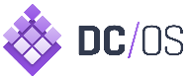
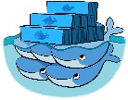

Choosing Orchestrators
Azure Product
Orchestrator | Description | Good for | Common workloads
 | Kubernetes is an open-source platform for automating deployment, scaling, and operations of application containers across clusters of hosts | Production-ready & Windows/Linux ecosystem | Microservices based on containers
 | As a datacenter operating system, DC/OS is itself a distributed system, a cluster manager and a container platform | Production-ready & Linux ecosystem | Microservices based on containers
 | Docker Swarm is a clustering and scheduling tool for Docker containers. With Swarm, IT administrators and developers can establish and manage a cluster of Docker nodes as a single virtual system | Production-ready & Linux ecosystem | Microservices based on containers
 | Azure Service Fabric is a distributed systems platform that makes it easy to package, deploy, and manage scalable and reliable microservices | Production-ready & Linux ecosystem | Stateful svc & Actors Microservices based on plain processes Microservices based on containers
Kubernetes
Azure Container Service
Mesosphere DC/OS
Docker Swarm
Azure Service Fabric
Service Fabric
Notes:
JER

Slide 43
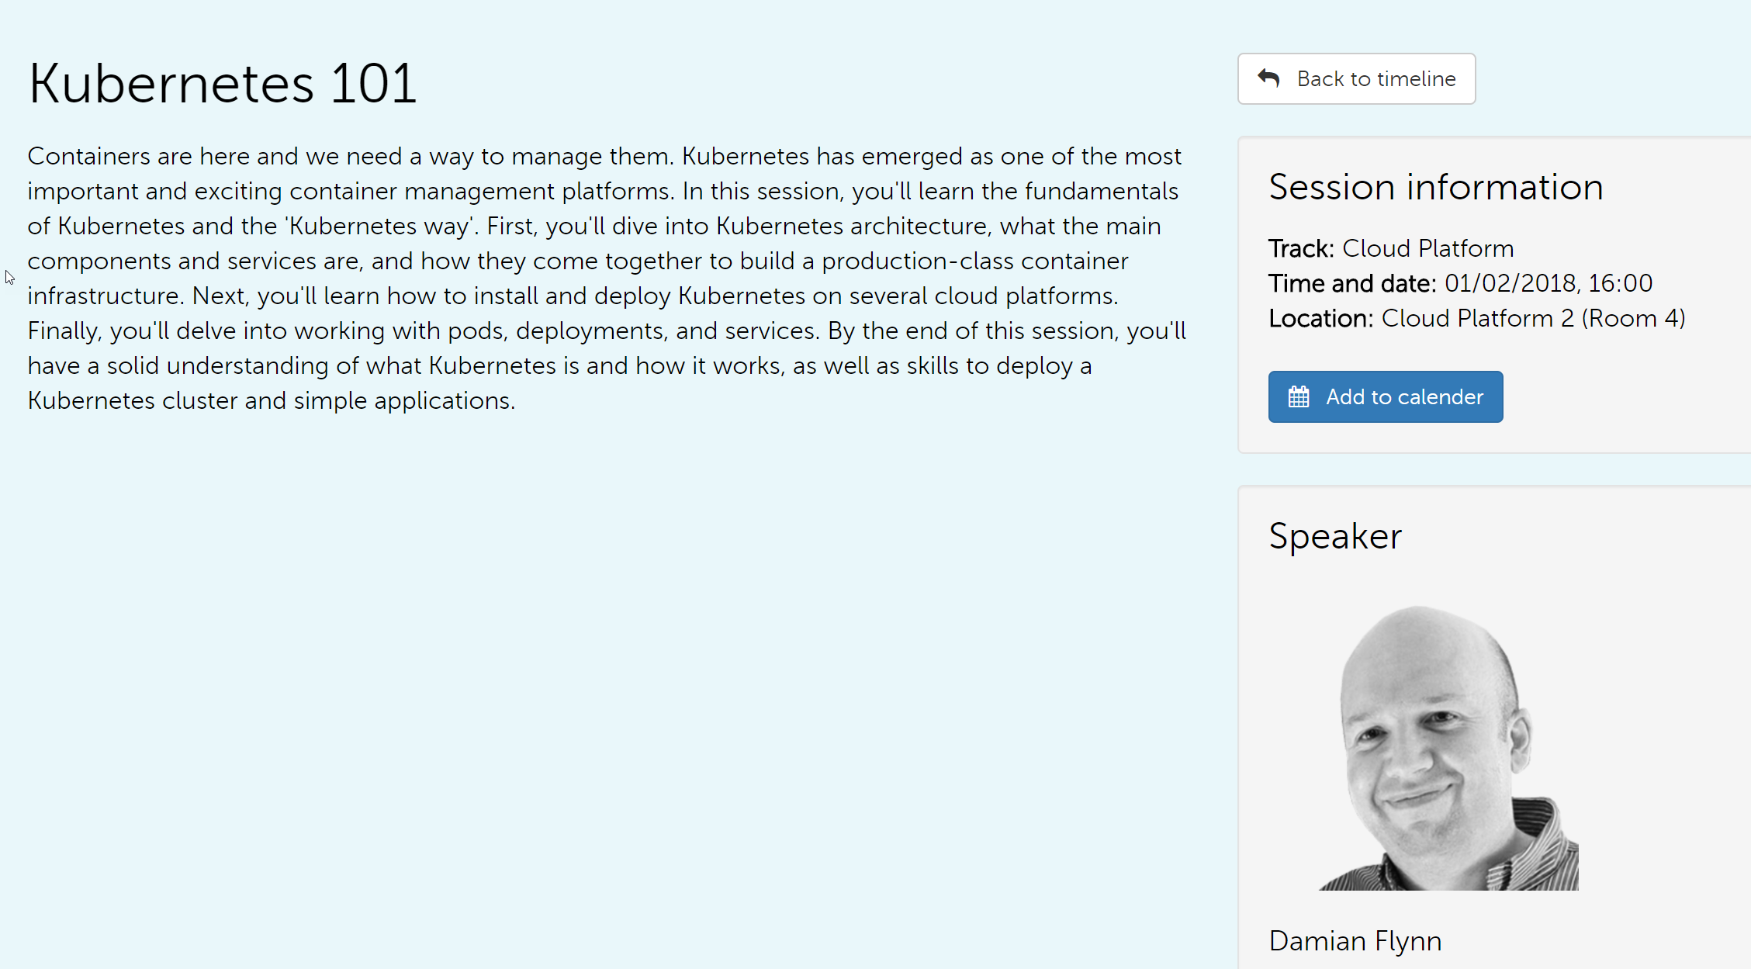
Notes:
OK

Slide 44
The future of containers
Notes:
OK

Slide 45


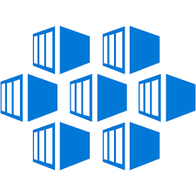

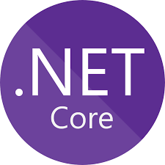













Existing .NET Application Modernization: Maturity Models
Existing Apps
.NET Web apps (on-prem.)
Cloud
Infrastructure-Ready
Cloud
DevOps-Ready
Cloud-Optimized & Cloud-Native
Full PaaS and Cloud-Native
Monolithic Architecture
Monolithic Architecture
Monolithic Architecture
Microservices and Monolithic Architectures
Relational Database
IaaS
+ Managed Services
PaaS + Managed Services
On-Premises
Azure
Azure
Azure
LIFT & SHIFT: No re-architect, no code changes
Architected for the cloud (Needs new code)
Notes:
OK
Slide from Ignite BRK3317

Slide 46
Resources
Docker Documentation
The Children's Illustrated Guide to Kubernetes
PowerShell Magazine – Containerizing a web application

Slide 47
About us
Øyvind Kallstad
Senior Consultant at Crayon
oyvind.kallstad@crayon.com
@OKallstad
Jan Egil Ring
Lead Architect, Infrastructure at Crayon
jan.egil.ring@crayon.com
@JanEgilRing
Notes:
JER

Slide 48
Thank you!
Notes:
JER

Slide 49
Bonus/backup content

Slide 50
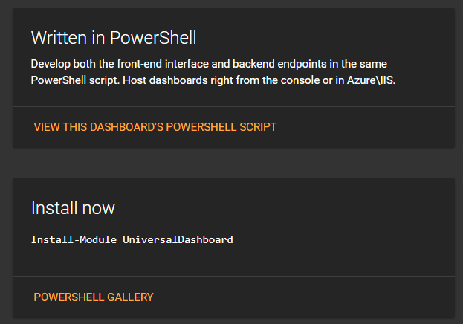
PowerShell Universal Dashboard
Universal Dashboard is a cross-platform PowerShell module for developing and hosting web-based, interactive dashboards.
Built on .NET Core – can run in both Nano and Windows Server Core
http://www.poshud.com
Demos
NIC.Containers\docker
NanoDemoWebsite
WindowsServerCoreDemoWebsite

Slide 51
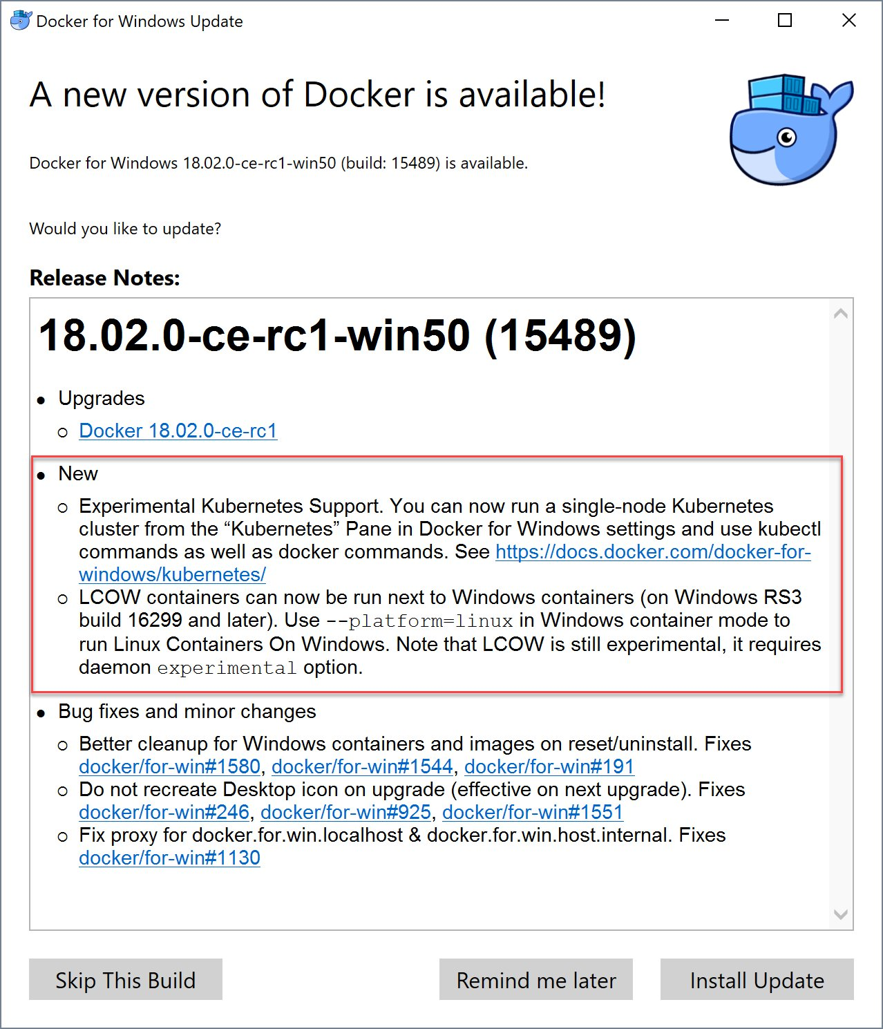
Available in Edge channel: Linux SxS & Kubernetes support

